Slide 1
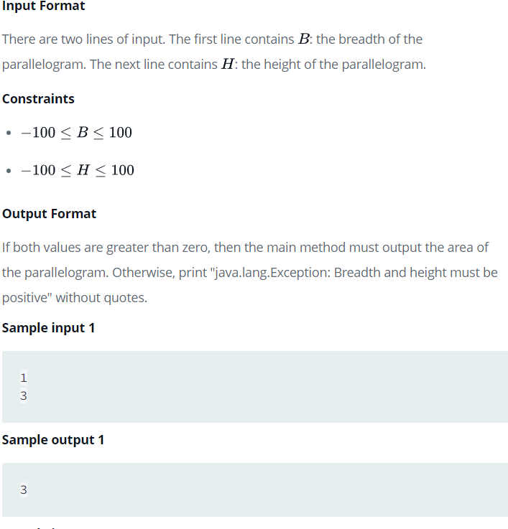
Problem 10th from HackerRank-

Slide 2
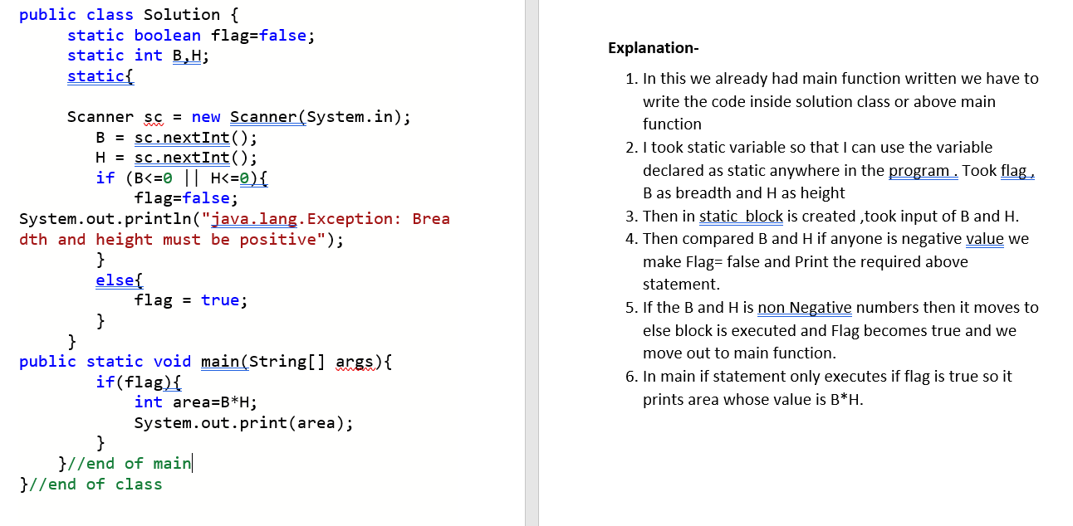
Solution 10th with Explanation-

Slide 3
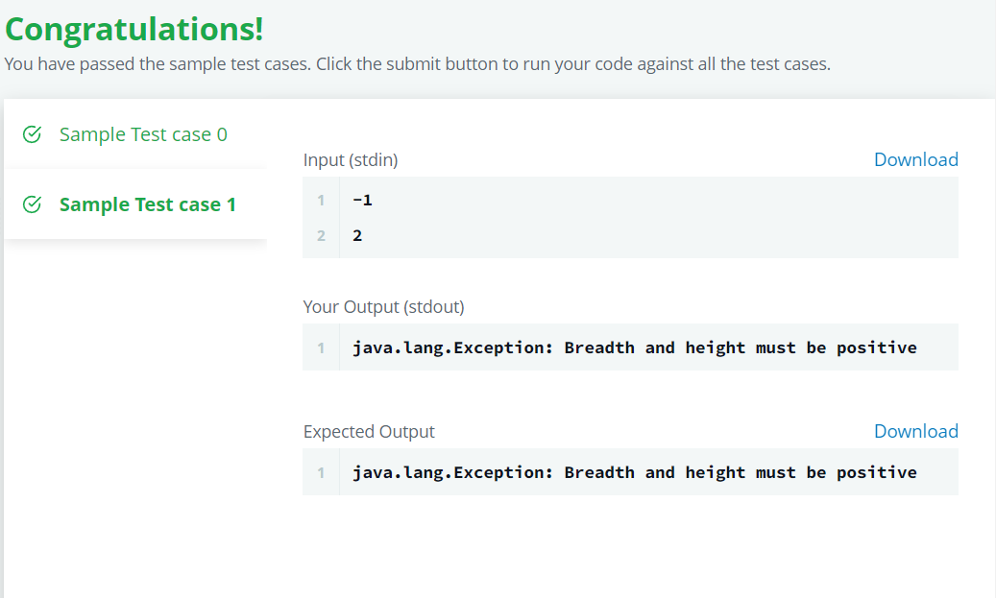
Output 10th

Slide 4
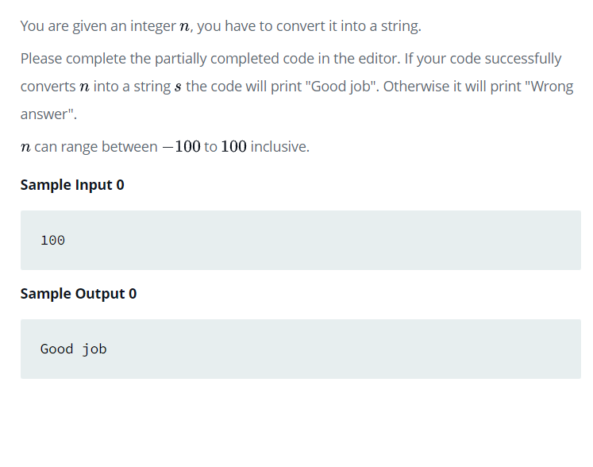
Problem 11th from HackerRank-

Slide 5
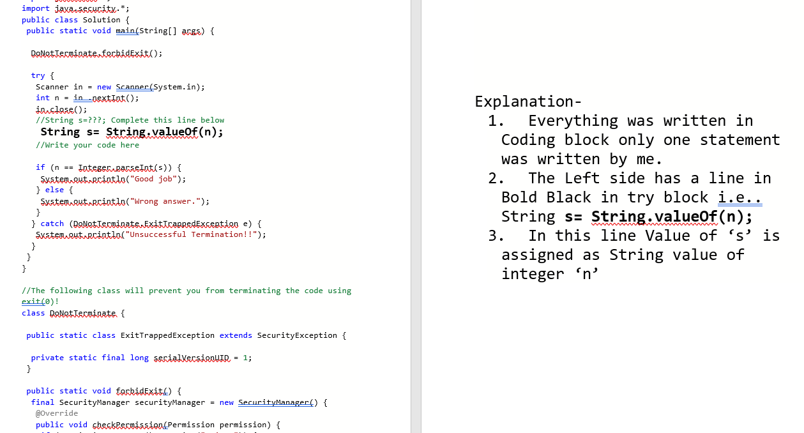
Solution 11th with Explanation-

Slide 6
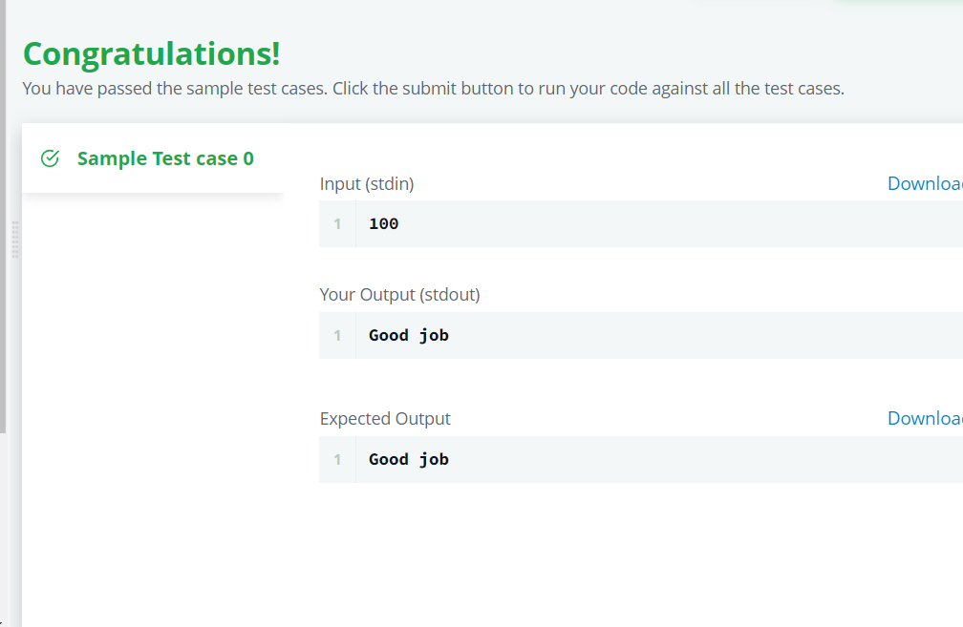
Output 11th

Slide 7
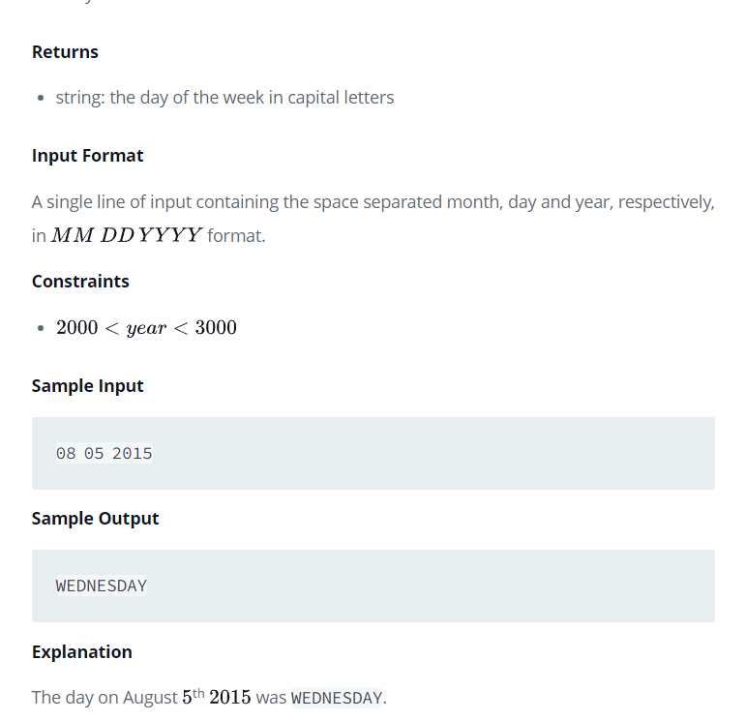
Problem 12th from Hacker Rank-

Slide 8
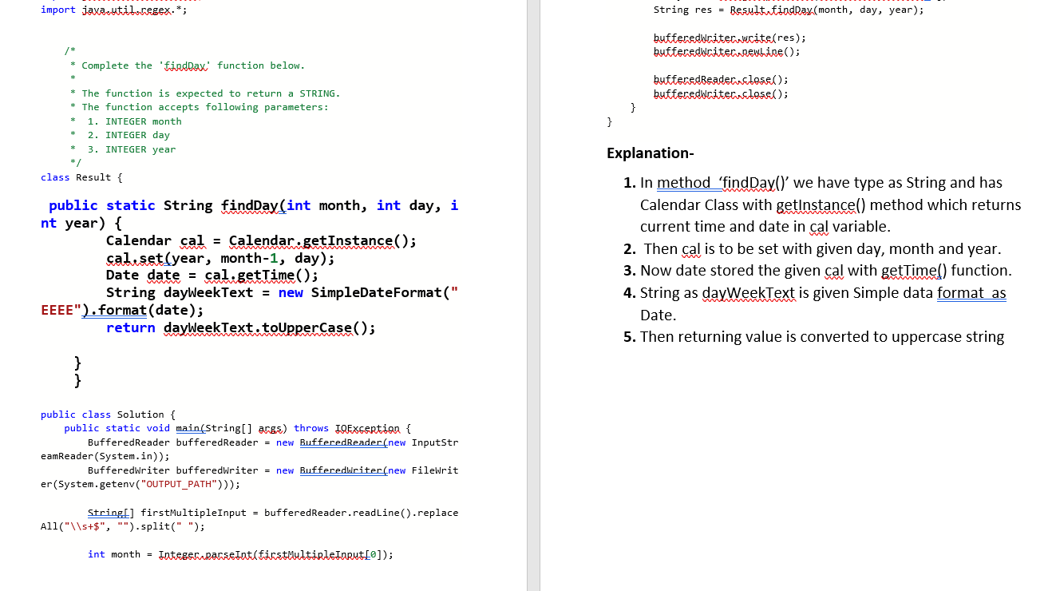
Solution 12th with Explanation-

Slide 9
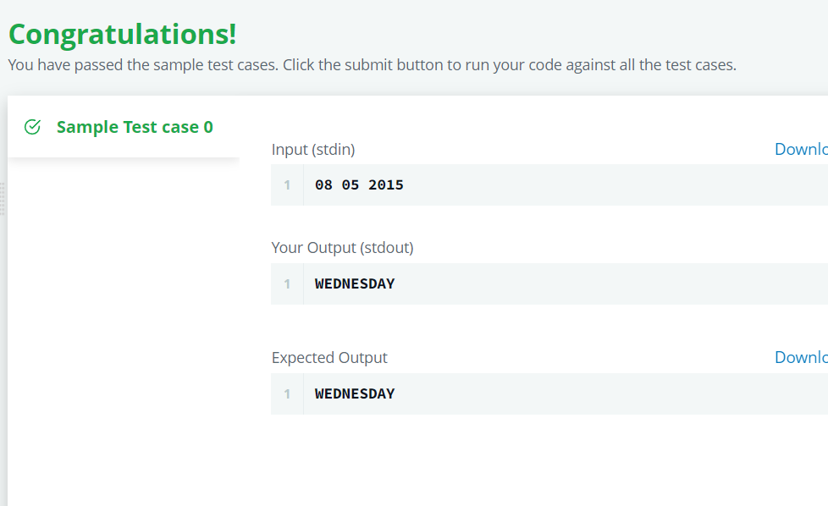
Output 12th -

